Slide 1
Cromarty Youth Café Report
Community Council 16th Aug – 17th September

Slide 2
Numbers:
Number of sessions delivered 35
Number of Participants 241
Number of Contact hours 323

Slide 4
Wider Achievement
In the last month young people have taken part in:
Preparing to Save a Life - Virtual College
Awareness-of-type-1-diabetes – Virtual College
Presentation Skills - Virtual College
How to Fill in Application Forms – Virtual College
Understanding Child Sexual Exploitation - CALA
Get Moving , Get Healthy – Virtual College

Slide 5
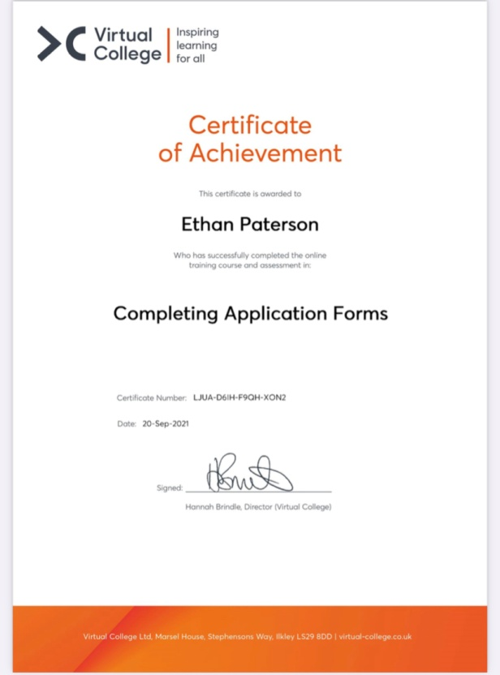
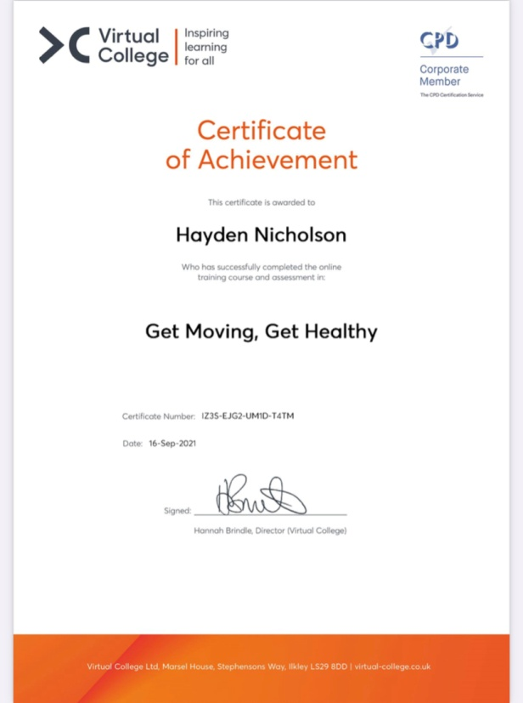
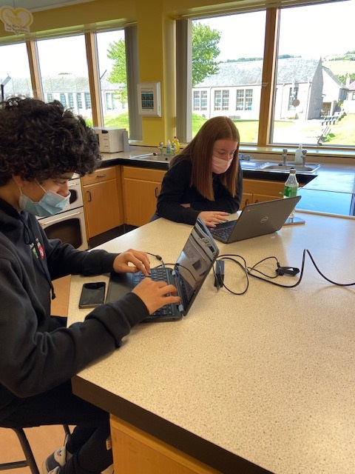
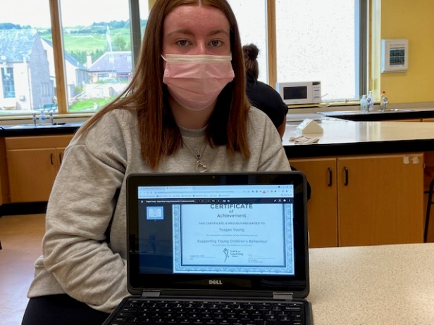

Slide 6
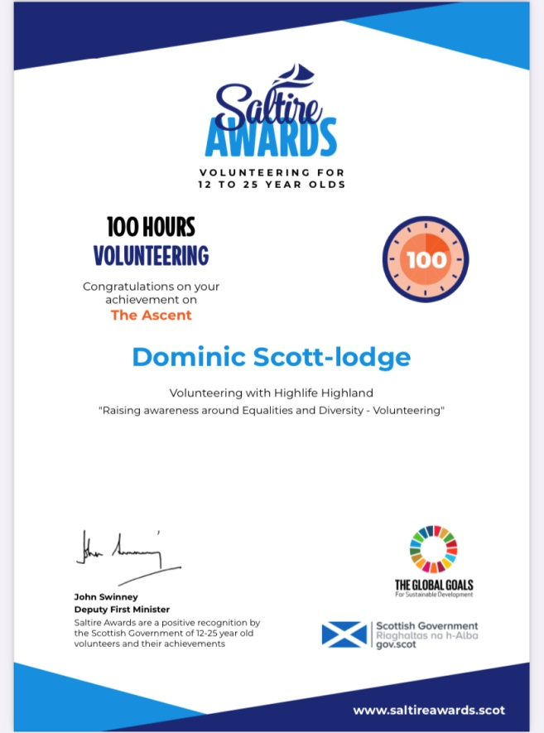
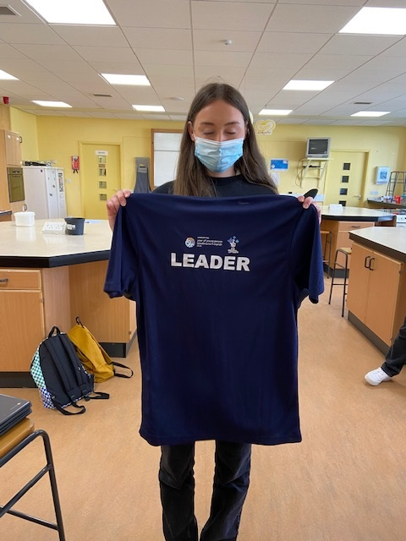
Saltire Awards & Highlife Highland Leadership Awards
Over the last month a number of young people have been in contact with myself to sign up for Saltire Awards and Highlife Highland Leadership Awards
Some of the young people’s awards have been backdated
There has been a number of awards given out over the last month.

Slide 7
Multi-Sports
This class is ran by 5 Highlife Highland young leaders on a Monday night
Each week the young people plan, prepare, deliver the session and then at the end evaluate it,
YP ask Fraser for the equipment needed for the following week to ensure we have got it.

Slide 8
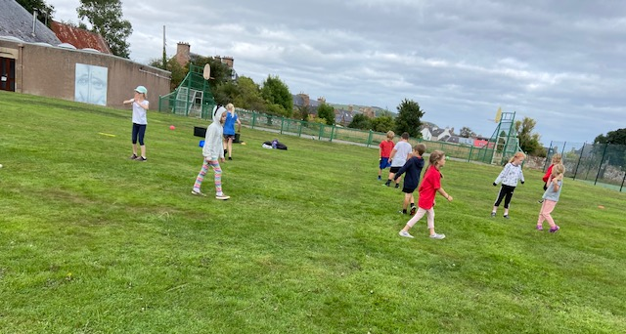
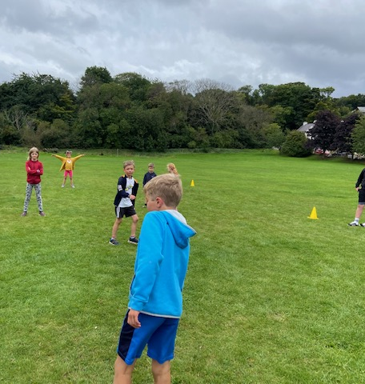
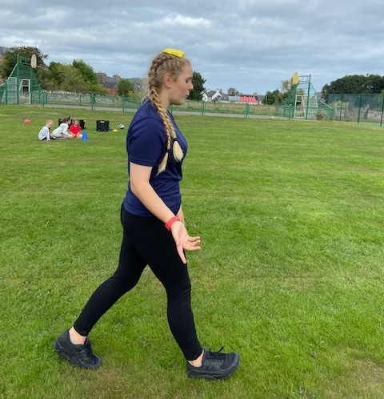
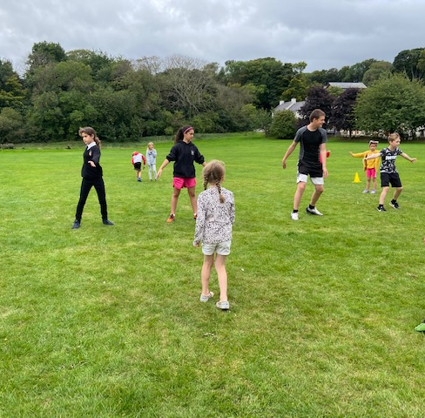

Slide 9
Jnr Youth Café
Jnr Youth Café has now moved to a Wednesday night due to staffing commitments as John is now in college
At Jnr Youth Café we are making the most of being outdoors,
Playing lots of fun games that young people want to play.
At every Jnr Youth Café Session young people are fed with a range a different snacks.
All the young people really enjoy taking part in the youth café

Slide 10
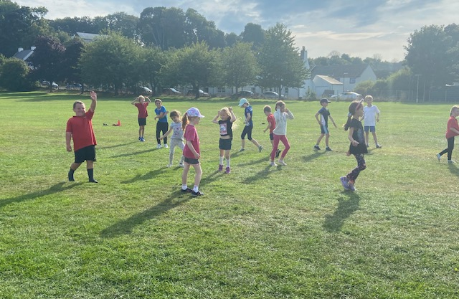
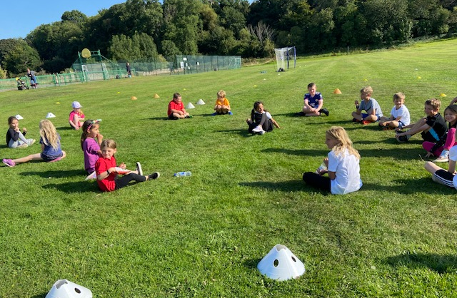
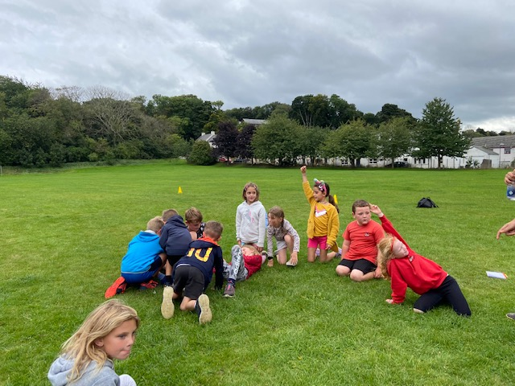
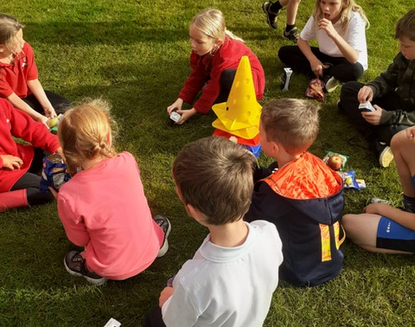
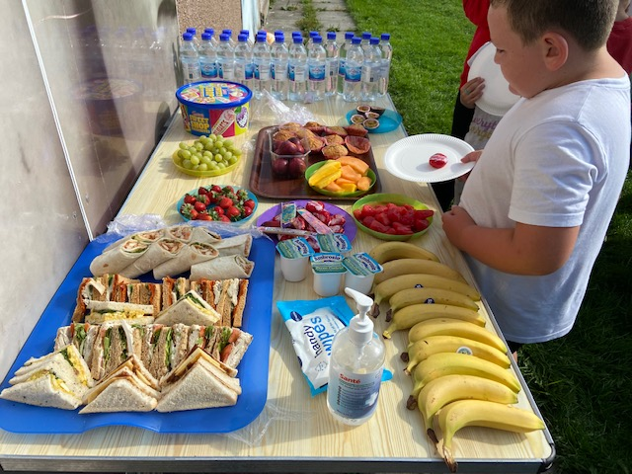

Slide 11
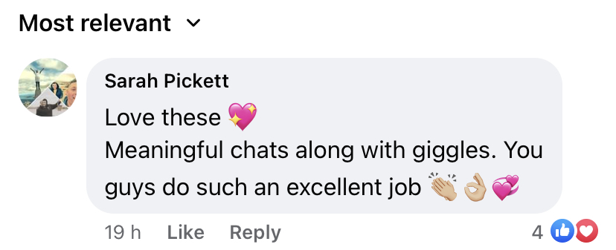
Snr Youth Café
At Snr Youth Café the young people asked if they could focus on their paperwork for leadership, saltire and different training courses after October when the weather turns.
We have been playing games in the park along with doing Walk and talks, each week we are taking a different route around Cromarty,
the first Walk and Talk was a loop of Cromarty, the young people told me they enjoyed the walk as it was good for their physical wellbeing
Parents Comment:

Slide 12
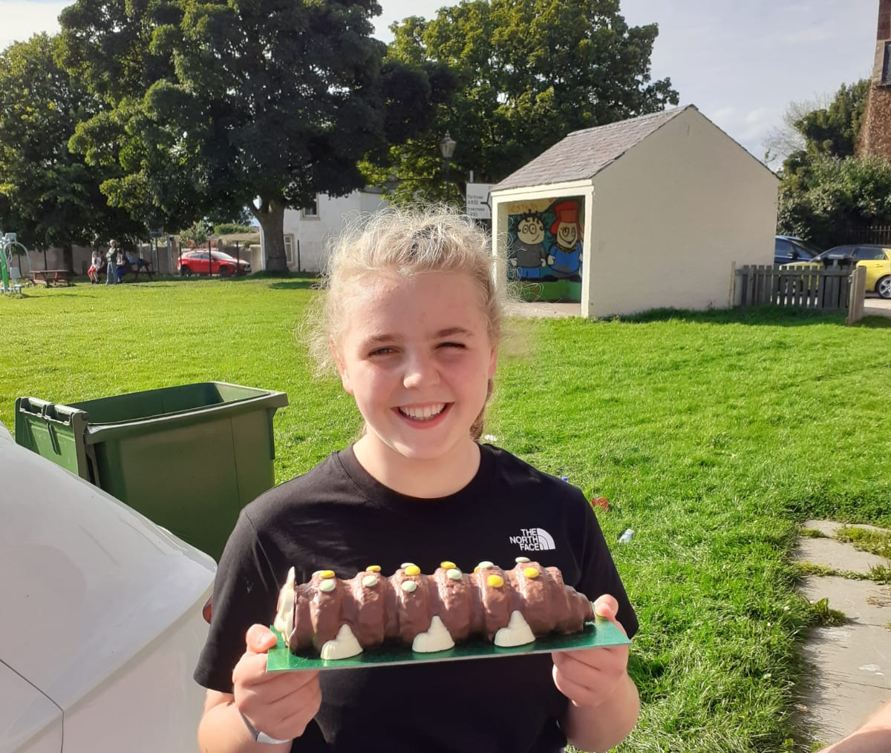
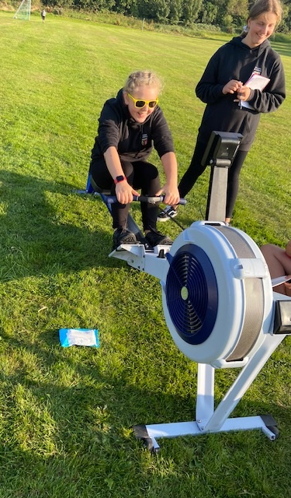
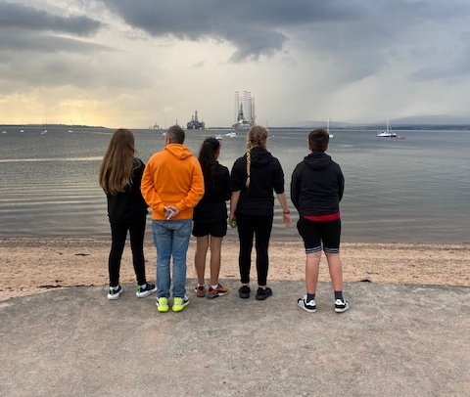
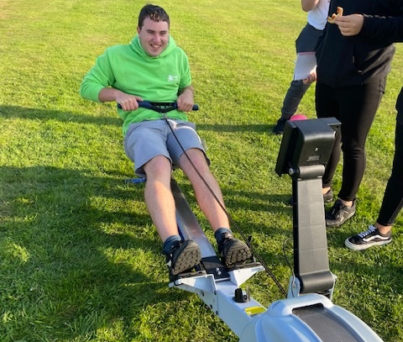
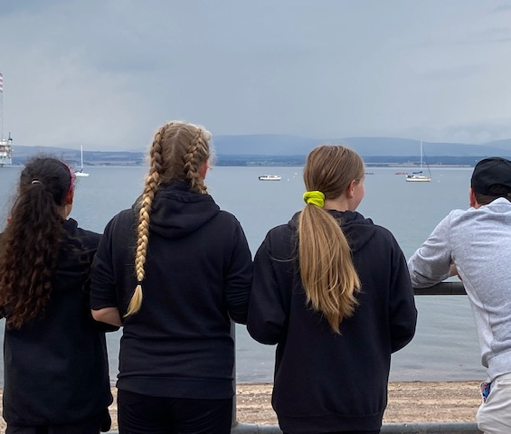

Slide 13
Football Coaching
Football coaching with Inverness Caley Thistle Youth Development Team is a huge success with around 30 young people turning up each week,
The young people are learning skills, drills, passing, scoring, teams skills, communication problem solving new rules and listening.
The young people engage really well with the coaches

Slide 14
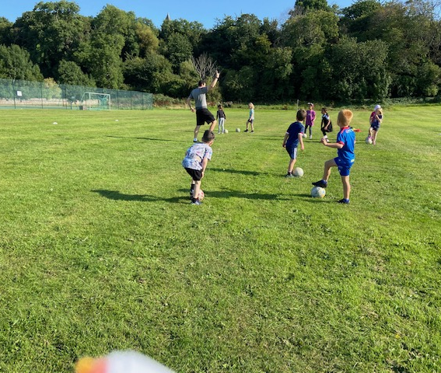
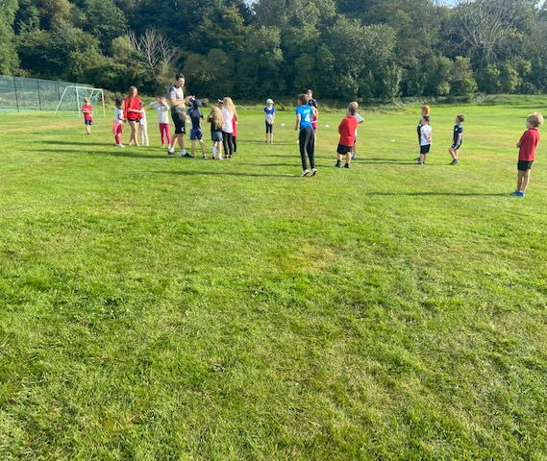
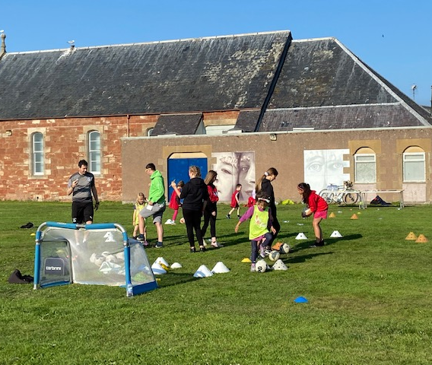
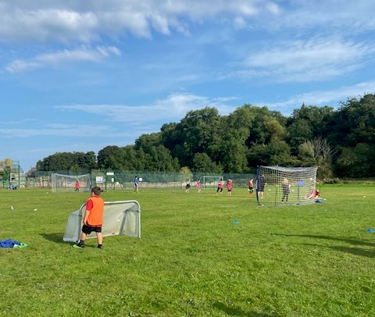
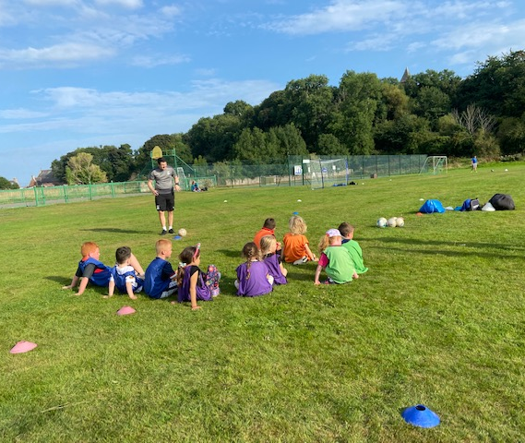
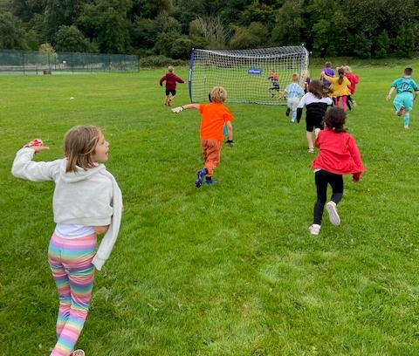

Slide 15
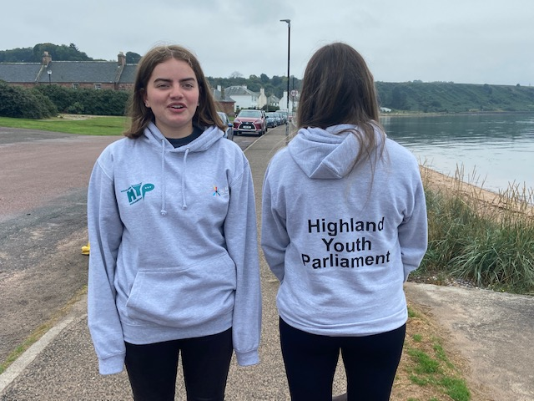
Highland Youth Parliament
On 16th / 17th September there was a 2-day virtual HYP “Mind Us” conference, focusing on mental health
Our Youth Reps have been consulting with young people about the issues or good news in out community to be fed in,
Review of life Skills & PSE., Looking at Exam Pressures, YDO and Equalities group taking part in the whole school survey , #helloyellowday, Loveleigh Project with YDO and Wellbeing on the Black Isle focus group, All YP understand Shanarri, Tilly’s poster for ITs ok to Say You're Not Ok! ,
Bloom Mental Health Project , S6 Mental Health Awareness , All Staff taken part in mental Health Training with PMHW
Google Classroom - was really good during lockdown being able to access YDO
Lots of Intergenerational work took place during Lockdown
Rowing in Cromarty
Lots of wider Achievement taken place
Another of the workshops was about App support, looking at which apps are good for mental health and some that are not good for mental health.
The girls focused well and spent a number of hours preparing for the conference

Slide 16
Intergenerational Work
In September Wanda was asked to present about the Intergenerational Work done on the Black Isle at the Scottish Learning Festival.
Below are a few short video links of what younger people and older people get out of intergenerational work:
Tilly Video - YouTube
Nancy Video - YouTube
John Munro - YouTube
Erin Lambert - YouTube

Slide 17
Rowing & Regatta
Over 20 youth rowers taking part in weekly rows.
Young people have been training to take part in the regatta on 25th September
Teagan & Tilly are the youth reps for rowing they have had the task of working on the rowing timetable and team selection for young people
In the regatta there is two categories for the young people:
Under 15 we have 3 boats competing in this category, Ingrid Rochford who owns Juniper has kindly lent us the use of the boat so that all young people will be able to race
Under 19 we have two boats competing in this category

Slide 18
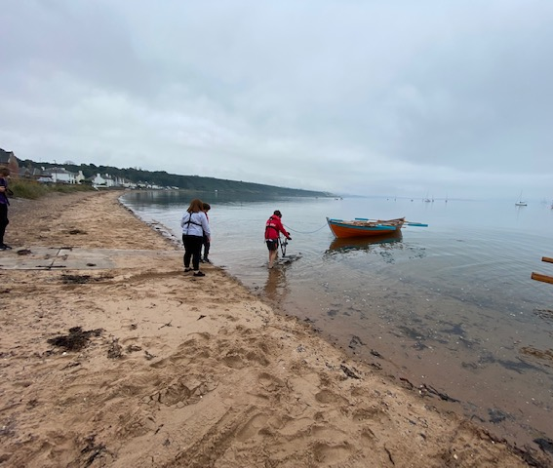
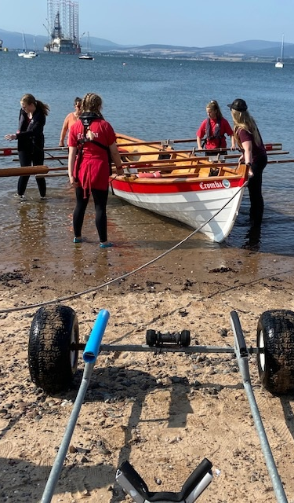
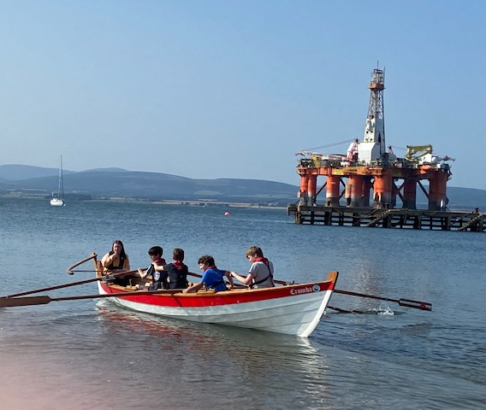
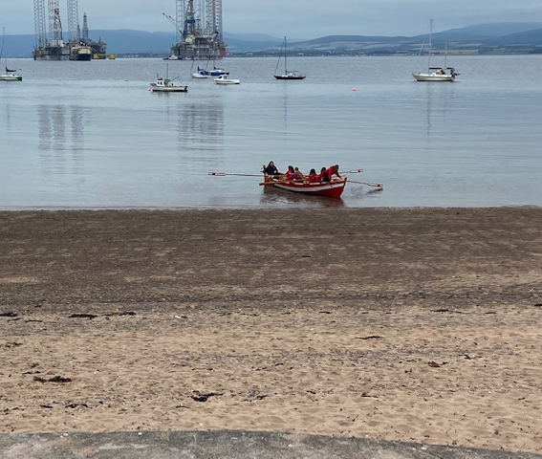
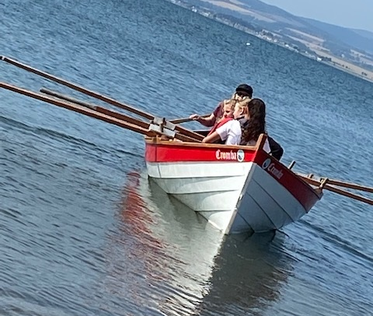

Slide 19
Cookwell / Bakewell
Lots of cooking and baking been happening over last few weeks
Lots of new recipes been taught and different types of food made
Baking delivered out to older people in the community

Slide 20
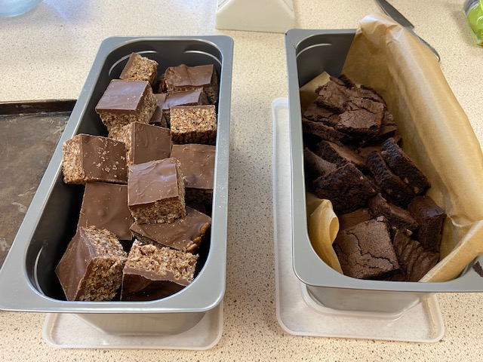
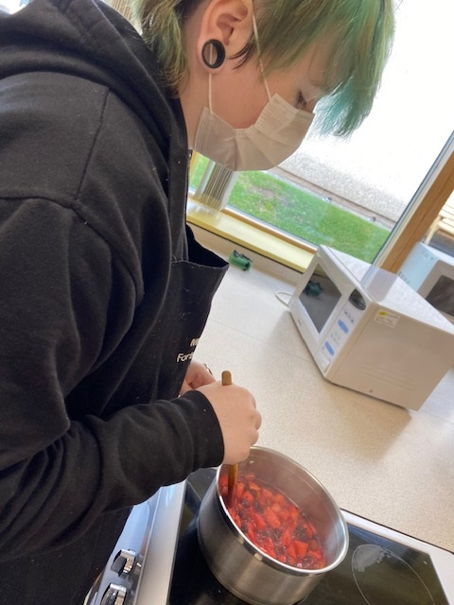
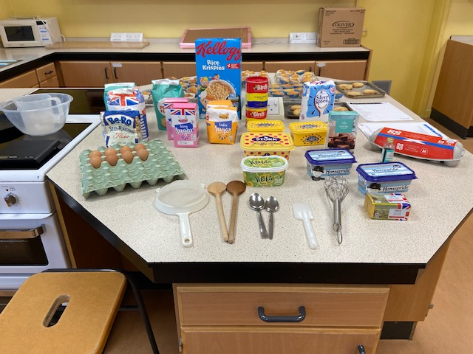
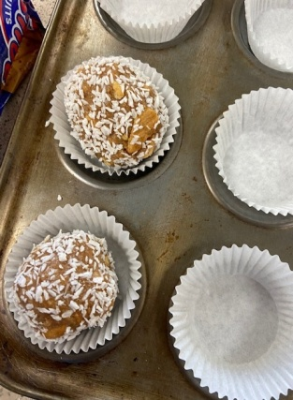
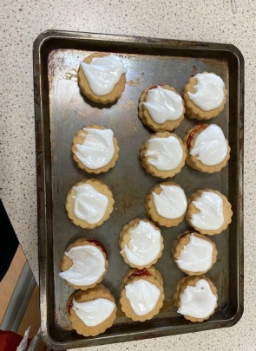
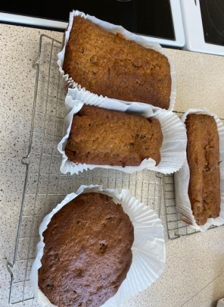
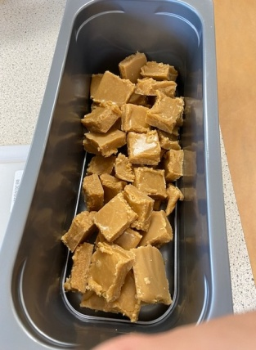

Slide 21
Equalities Steering Group
The group have met with Zara from Waverly Care to talk about developing The Resilience programme to help with the developing the new P.S.E review.
The P.S.E review is a consultation for young people their voice heard about what should be in P.S.E
The group are just about to do a SHANARRI survey to find out how people feel and if the school is equal.

Slide 22
Funding
Scotmid Funding application has been submitted for vouchers towards cookwell Supplies
Rural Action Fund – Application submitted for Cookwell & Bakewell equipment and ingredients, this was done on the back of Youth Scotland being in touch with Wanda asking for her to do a case study about the Gazebo and young people taking part in youth work outdoors
Tesco Bags of Help – Application Submitted and approved, so if you shop in Dingwall Tesco, please drop the tokens in the Cromarty Youth Café Slot between October and December

Slide 23
Working Group / Committees we are on:
Black Isle Health and Well being Focus Group
Cromarty Community Rowing Club – Wanda is the youth leader
After a suicide Subgroup – Wanda

Slide 24
Going forward
Myself and John are going to be starting the Resilience in Your Community with Support in Mind Scotland looking at young people's resilience coping strategies
October Programme Planning lots of fun exciting opportunities coming up
Planning for Winter Months
Developing young people wider achievement and learning for life
Wanda & myself are going to completing the International Diploma in Intergenerational Learning (IDIL)

Slide 25
Thank You for taking your time in reading this report. As ever if you want to speak about any of the projects please contact me. To keep up to date with what we are up please check our Facebook Page. Fraser Thomson Assistant Youth Worker Cromarty Youth Café

